Slide 1
Logistic Regression
Abhijit Ramesh Patil

Slide 2
What is logistic regression?
“Logistic regression is classification algorithm that is used where response variable is categorical”
e.g. To predict if student passes or fails in exam when the number of hours spent studying is given as feature, the response variable has two values (pass and fail)

Slide 3
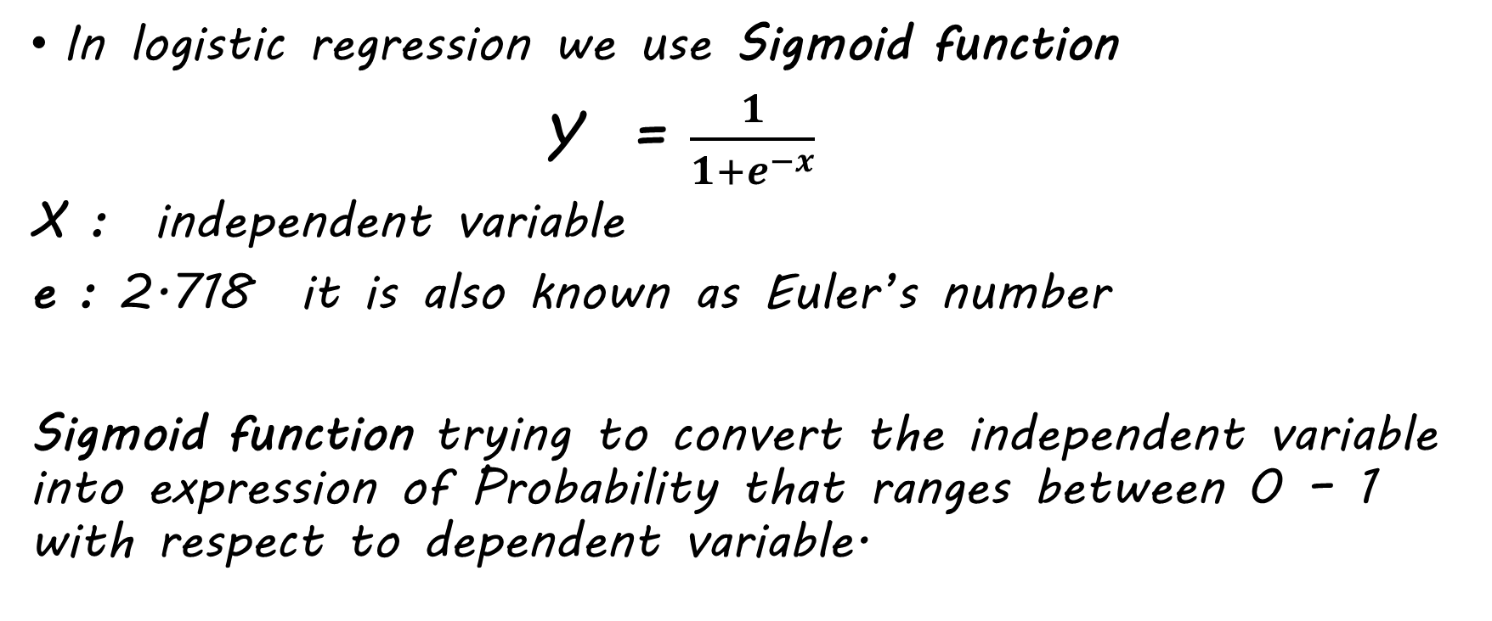
What function we use in logistic regression?
In logistic regression we use Sigmoid function
Y = $\frac{1}{1+e^{−x}}$
X : independent variable
e : 2.718 it is also known as Euler’s number
Sigmoid function trying to convert the independent variable into expression of Probability that ranges between 0 – 1 with respect to dependent variable.

Slide 4

What is e and x in sigmoid function ?
Sigmoid function
Y = $\frac{1}{1+e^{−x}}$
X : independent variable
e : 2.718 it is also known as Euler’s number

Slide 5
What are applications of logistic regression?
Application of logistic regression
Fraud detection
Disease diagnosis
Emergency detection
Spam no spam

